Slide 1
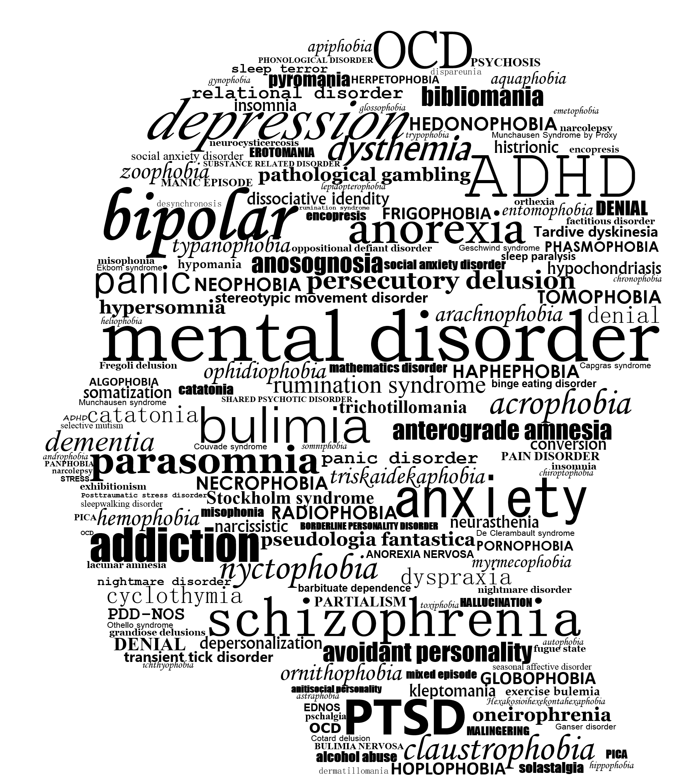
For many psychiatric symptoms, there is a mild form of the same mechanism of behavior that serves adaptive purposes in healthy people.
Paget Michael Creelman

Slide 2


Slide 3


Slide 4
Do computational quantities have physiological correlates?
To what degree do aversive vs. neutral stimuli bias behavior?
… could this degree potentially be used as diagnostic tool in computational psychiatry?

Slide 5
[experiment]

Slide 6
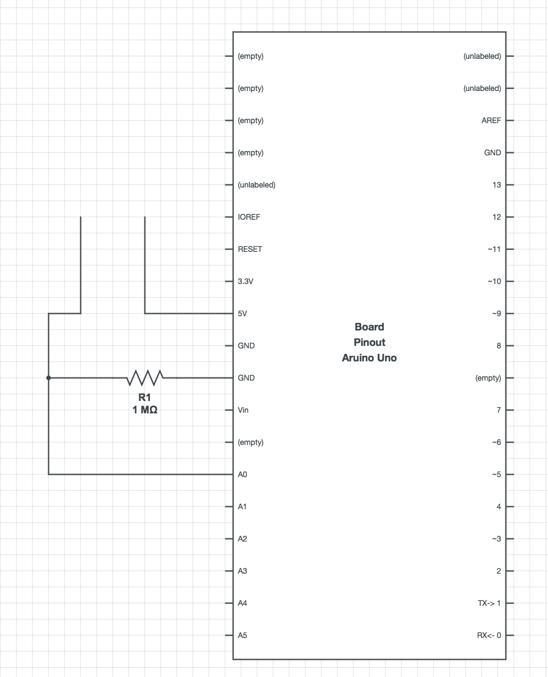
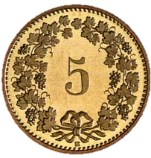

Slide 7
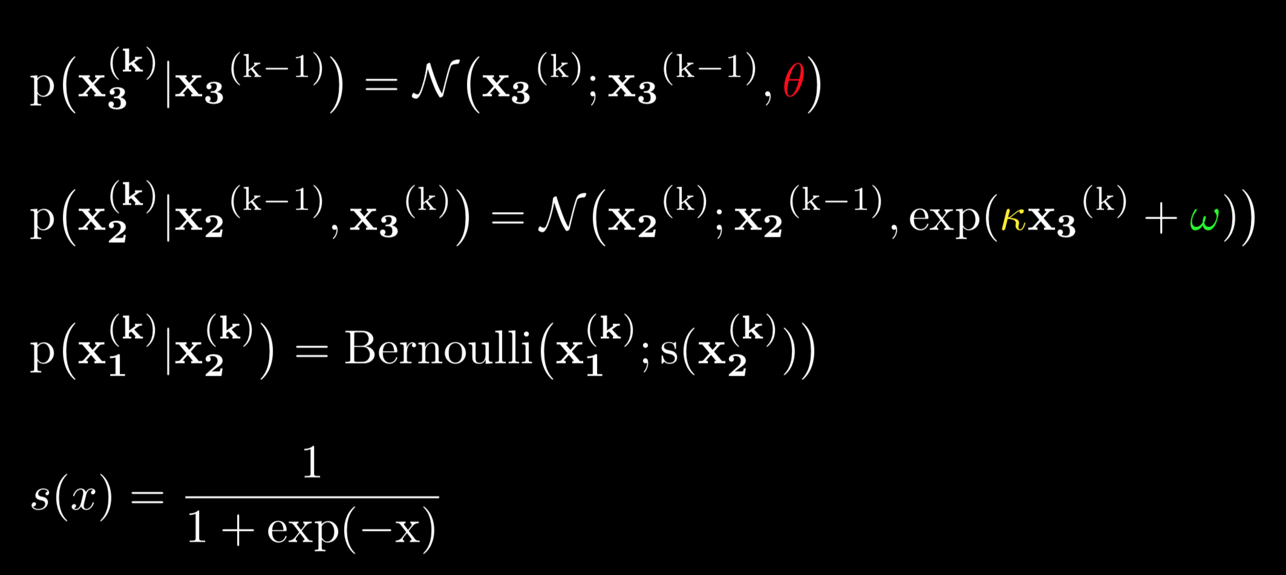
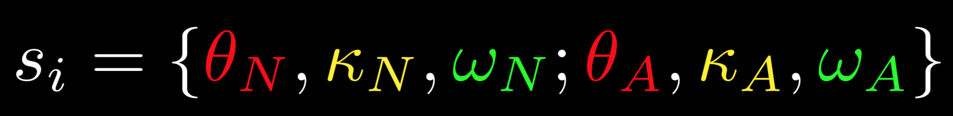
The HGF – A generative model of behavior
variance of volatility
How can we simulate a binary choice?
phasic
tonic
For every subject $s_{i}∈S$, we fit an HGF and obtain parameter sets for neutral and aversive blocks.

Slide 8
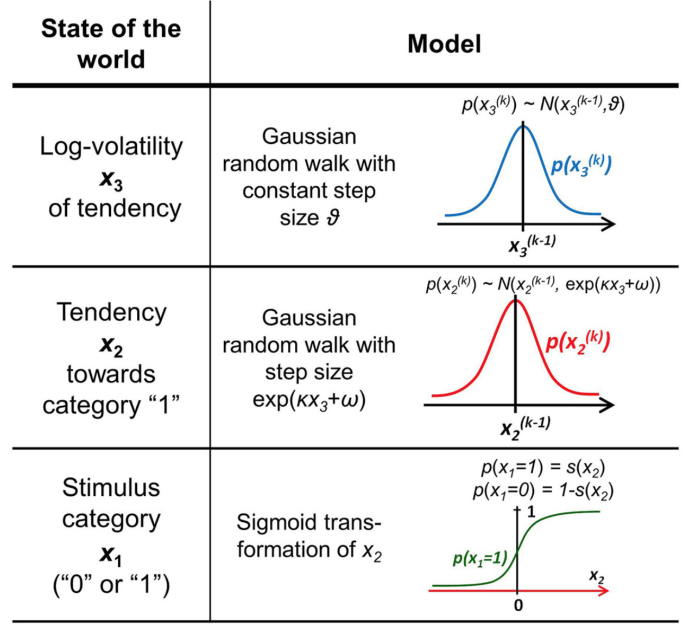
The HGF – A generative model of behavior
STIMULUS CATEGORY and TENDENCY to be read in cue-stimulus-contingency terms:
1 is defined as square → no tone or circle → tone
0 is defined as square → tone or circle → no tone
To what degree do aversive vs. neutral stimuli bias behavior?
Fit HGFs for both neutral and aversive blocks for all subjects and compare parameters.

Slide 9
[analysis]

Slide 10
Do computational quantities have physiological correlates?
To what degree do aversive vs. neutral stimuli bias behavior?
… could this degree potentially be used as diagnostic tool in computational psychiatry?
... possibly, but we need more good data to consolidate our findings.
... they do, in a direction that is subject-dependent.
... potentially, if tested on disease cohorts, and especially owing to the interpretability of the Pseudo-Bayesian model

Slide 11


Slide 12
References
By Paget Michael Creelman - Own work, CC BY-SA 4.0, https://commons.wikimedia.org/w/index.php?curid=67346556

